Slide 1
Social Media Marketing
Major Project

Slide 2
Q1. Create a Facebook ads account and paste the Facebook Account ID/Ad manager ID here.
Michael Gnk (1478707929728292)

Slide 3
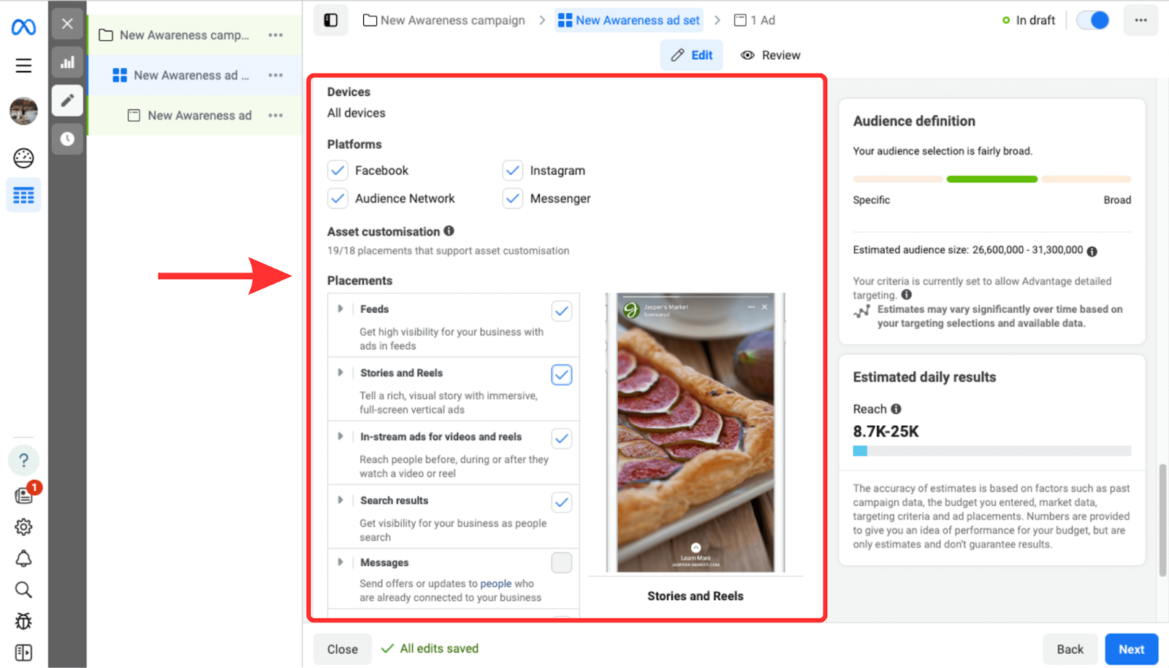
Q2) Create an ad for Facebook and Instagram for any one of the following:
● Digital Marketing Course
● 2 BHK flats for sale
● Gaming laptop
● Packaged juice

Slide 4
Q3) Create a lead generation Ad for any one of the following:
Ad Title: "Get Started with Our Free Digital Marketing Course!"
Ad Copy: Ready to kick start your journey into the world of digital marketing? Sign up now for our FREE Digital Marketing Course and gain valuable insights and skills to elevate your career. Whether you're a novice or seasoned professional, our course offers:
✅ Comprehensive modules covering SEO, PPC, Social Media Marketing, and more.
✅ Interactive learning materials and quizzes to reinforce your knowledge.
✅ Expert guidance from industry professionals with years of experience.
✅ Flexible online learning options to fit your schedule.
Don't miss out on this opportunity to invest in yourself. Join thousands of learners already benefiting from our course!
Call to Action (CTA): "Sign Up for Free!"

Slide 5
Image: An engaging image featuring a person using a laptop or tablet, surrounded by digital marketing icons and graphics, indicating the dynamic and evolving nature of the field.
Platform: This ad can be run on Facebook and Instagram to target individuals interested in digital marketing, career advancement, or personal development.

Slide 6
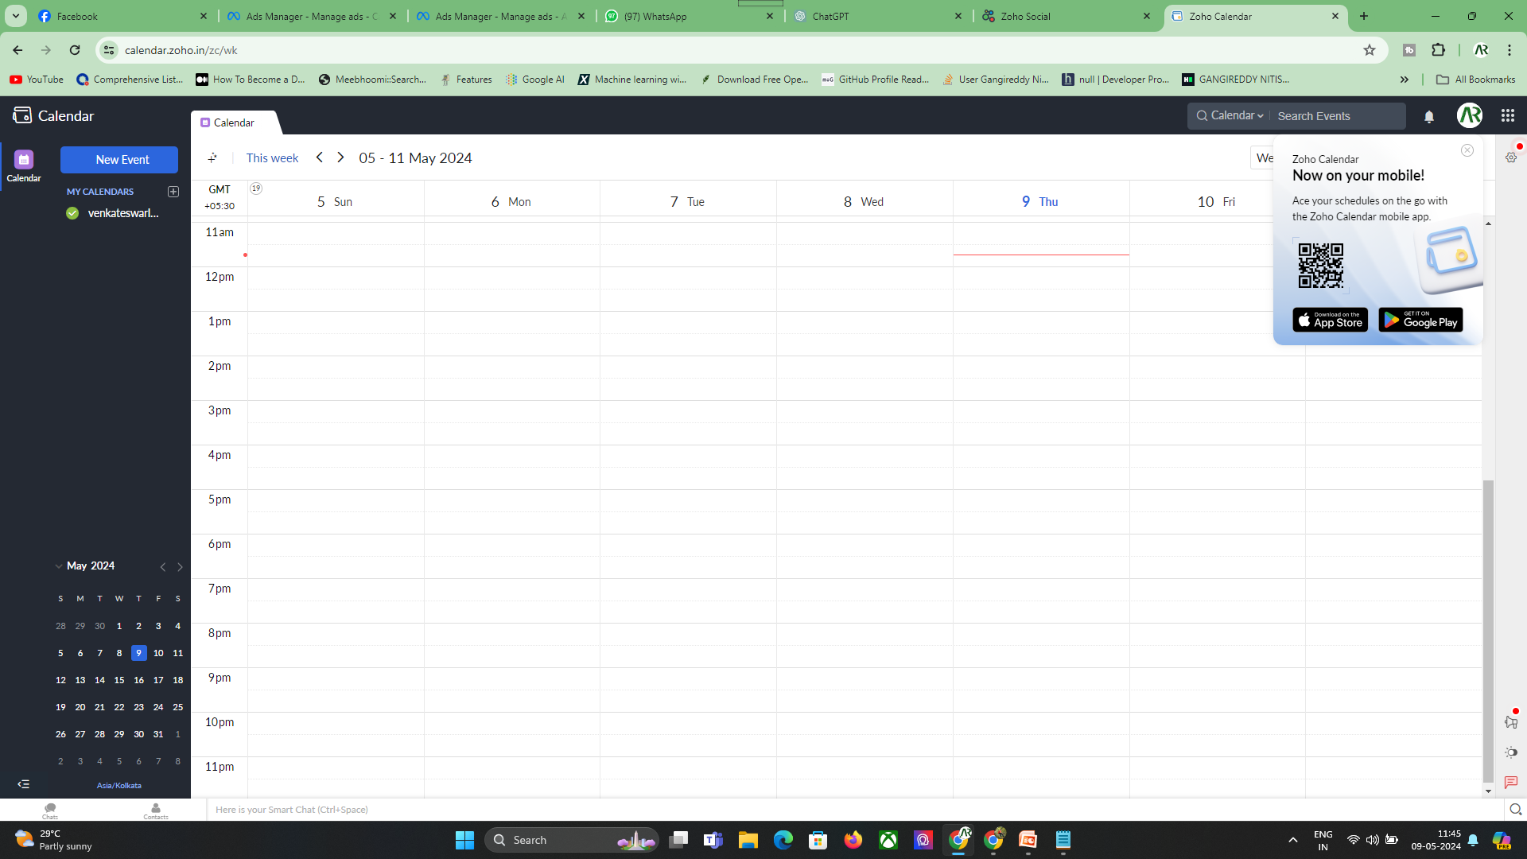
Q4) Create a free trial account with ZOHO social and perform the following tasks: ● Create a content calendar (attach a screenshot)

Slide 7
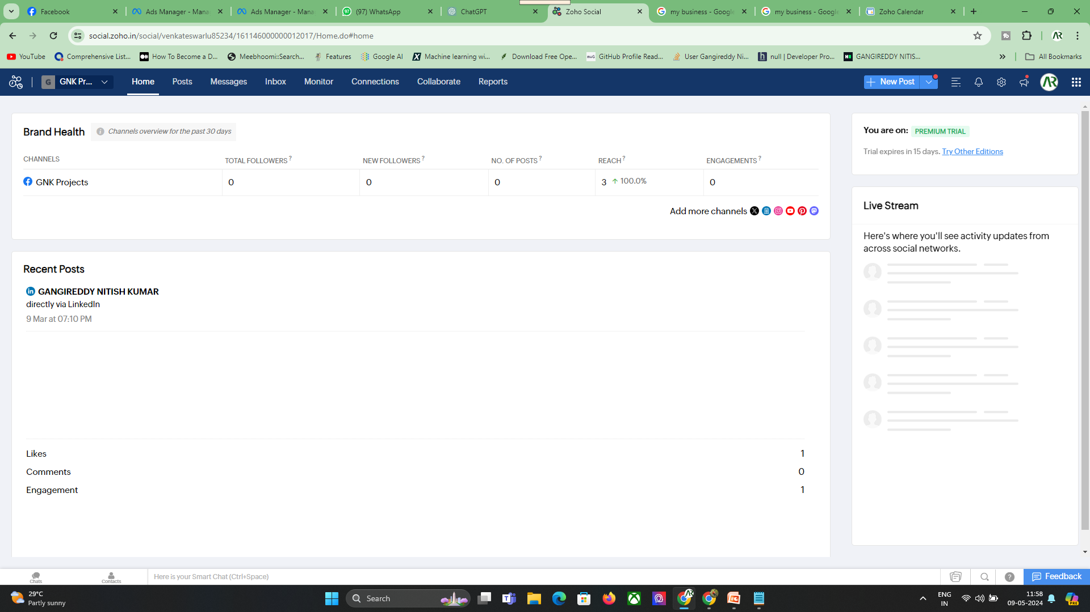
● Connect any 2 social media channels (attach a screenshot)

